Slide 1



Name of Course: Engineering Mechanics
Course code: 216U06C104
Module 2: Kinematics of Particles & Rigid Bodies
2.1: Resultant of forces in Forces

Slide 2
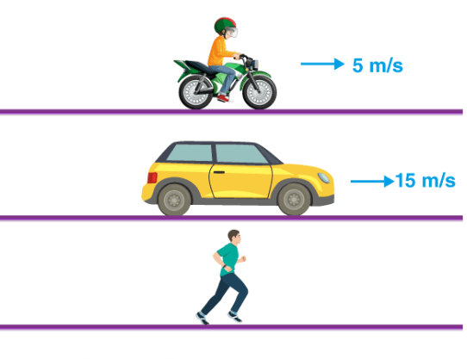
Module 2 – Kinematics of Particles & Rigid Bodies Module Section 2.1 – Kinematics of Particles
Kinematics: It is concerned only with the study of motion of the body without consideration of the forces causing the motion.
Rectilinear Motion: Motion of a particle in a straight line is known as a rectilinear
motion.
e.g. car moving on a straight highway, lift traveling in a vertical well, etc.
Position (x), Displacement (s),
& Distance (d):

Slide 3
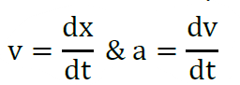
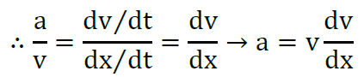
Types of Rectilinear Motions
1. Uniform Velocity Motion
If a particle’s velocity remains constant throughout the motion, then it is said to be under motion with uniform velocity. E.g., motion of sound, package on a conveyor, etc.
2. Uniform Acceleration Motion
If a particle’s velocity changes at a constant rate throughout the motion, then it is said to be under motion with uniform acceleration. This means that its acceleration is constant. This gives us the equations of kinematics.
3. Variable Acceleration Motion
If a particle’s acceleration itself is changing throughout the motion, then it is
said to be under the motion with variable acceleration.
v= u+at
S= ut+ at²
v²- u²=2aS
u= initial velocity of the body
v= final velocity of the body
s= distance travelled by the body in motion
a= acceleration of the body
t= time taken by the body

Slide 4
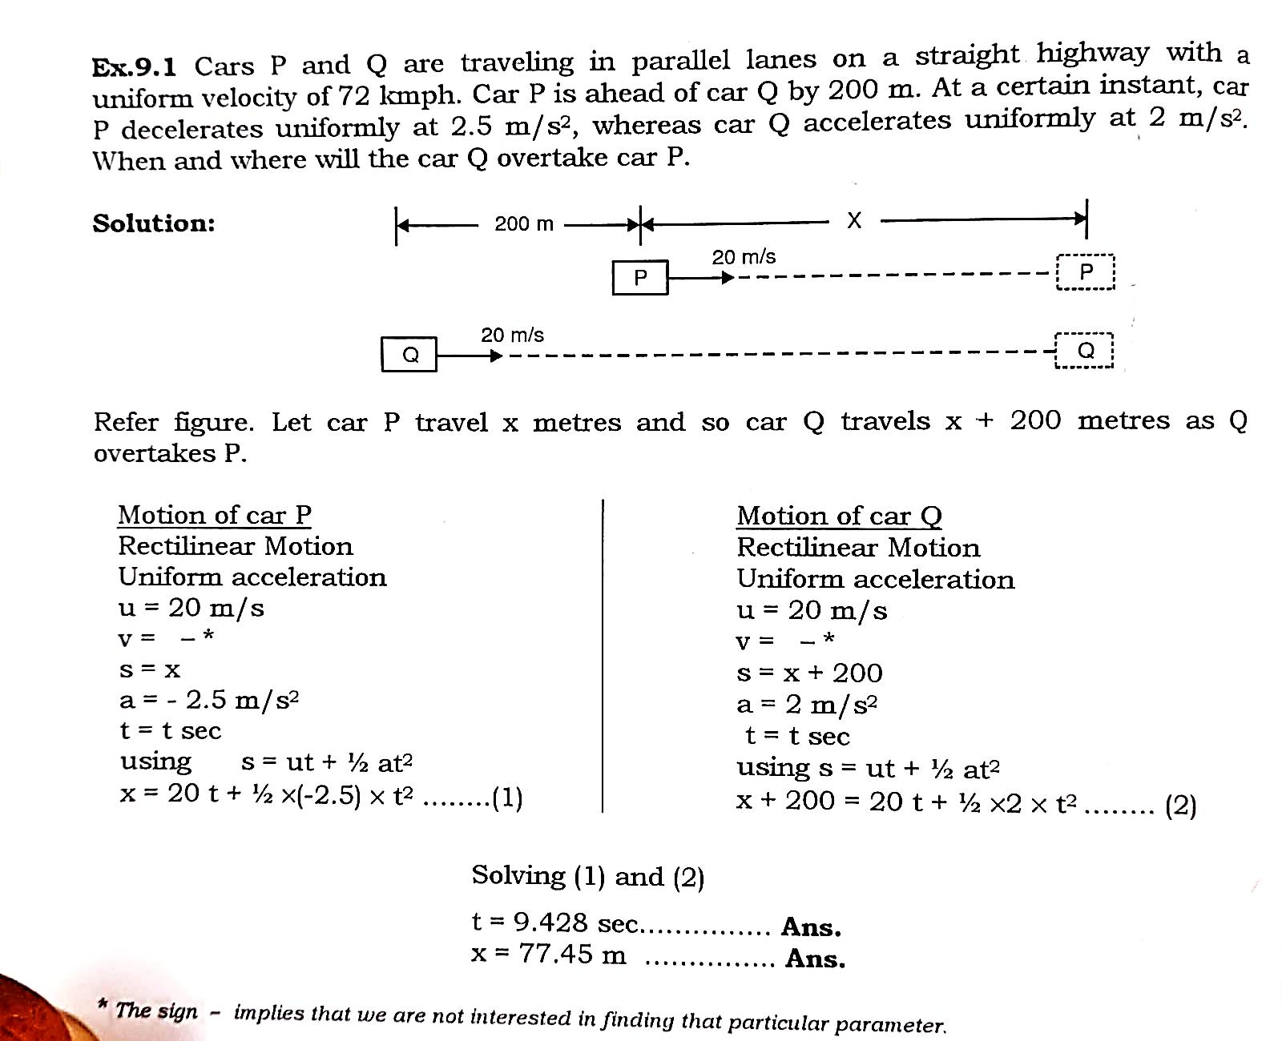

Slide 6
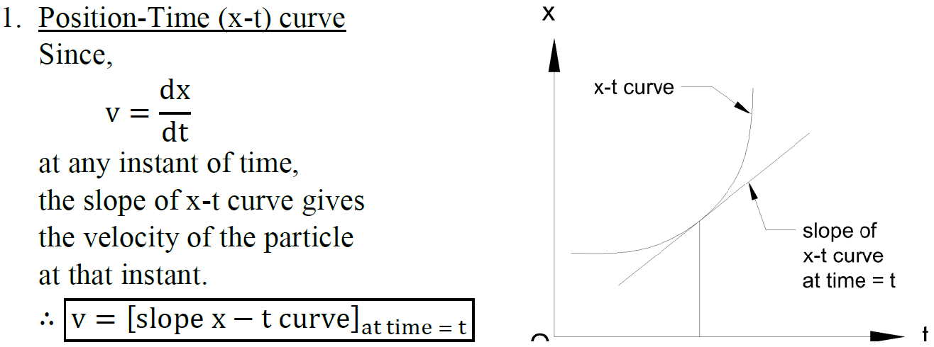
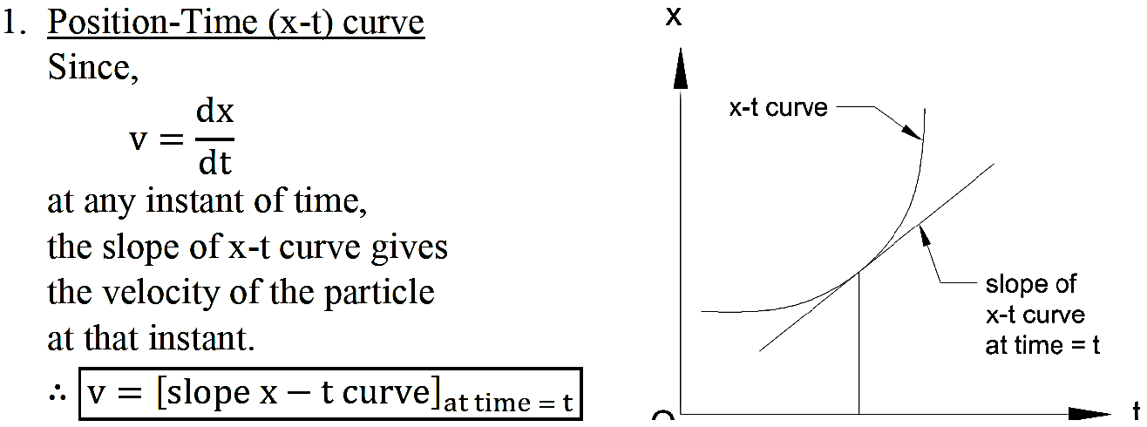
Motion Curves: The motion of a particle along a straight line can be represented by
motion curves. They are the graphical representation of position, displacement,
velocity and acceleration with time.

Slide 7
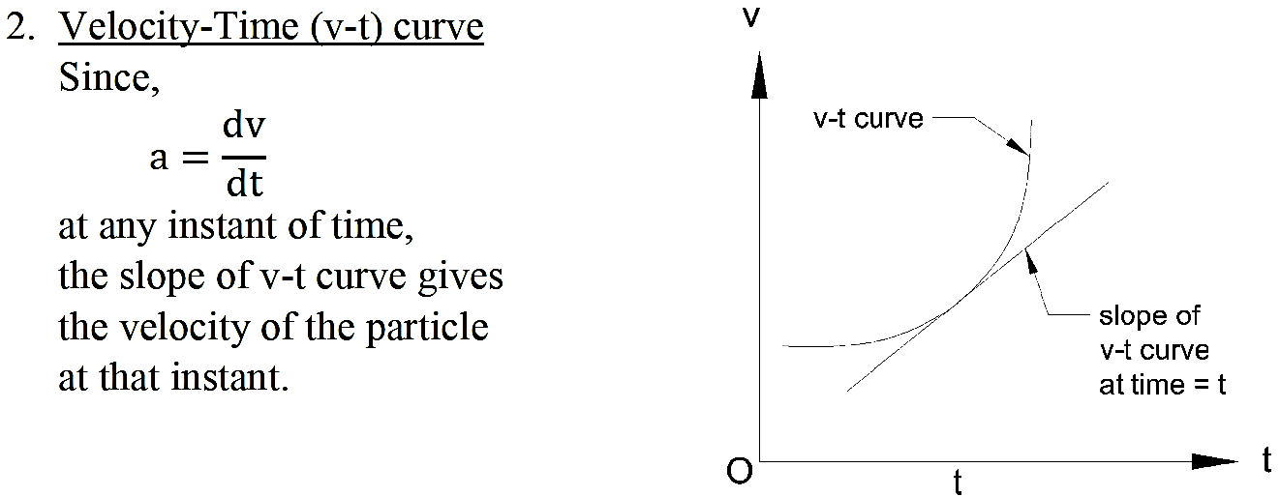
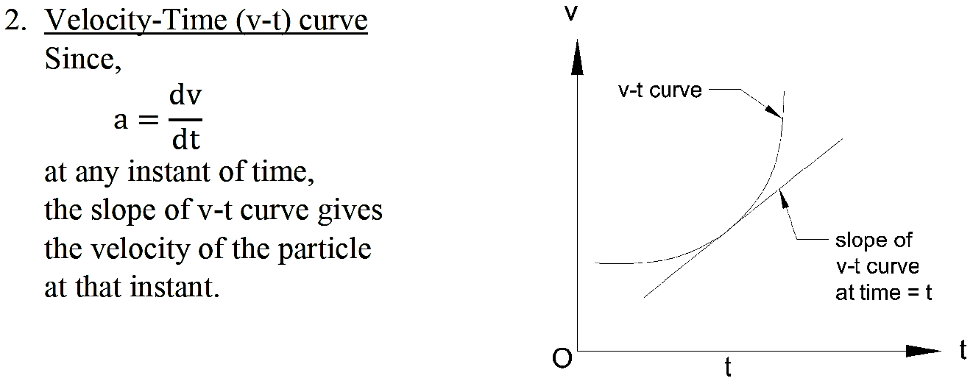
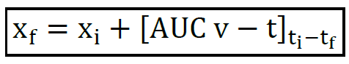

Slide 8
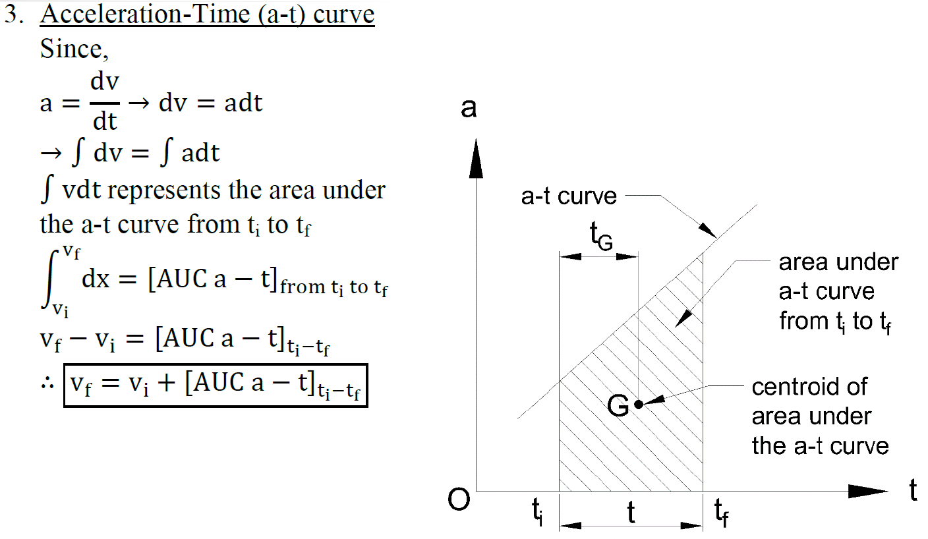

Slide 9
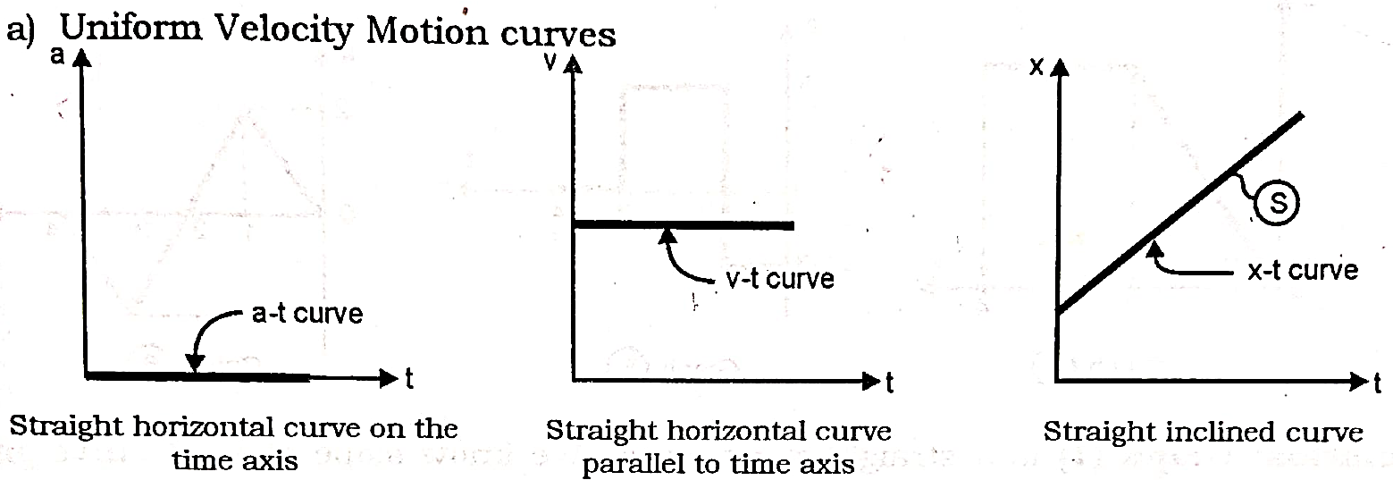
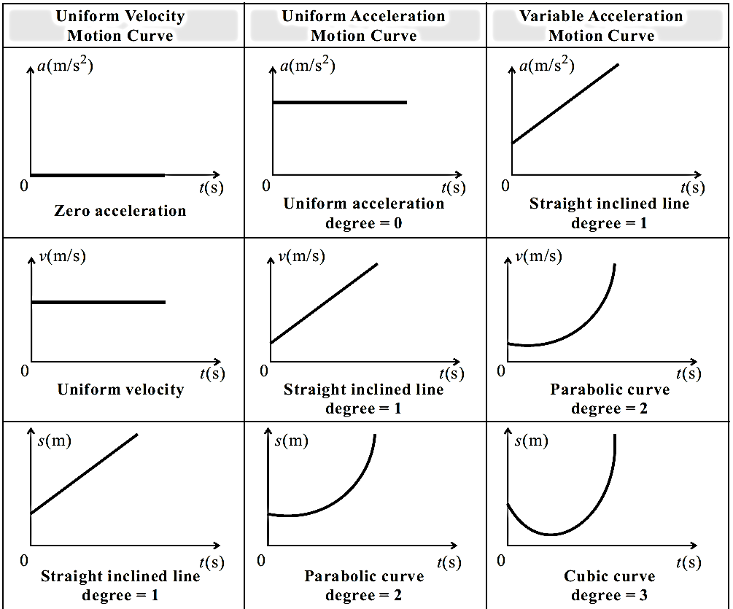
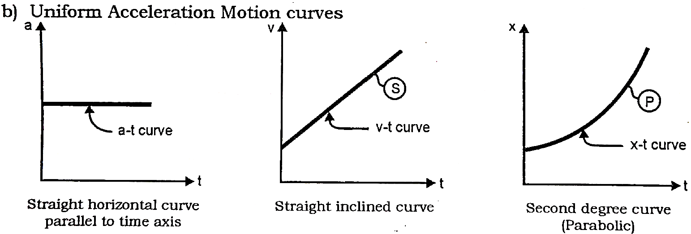
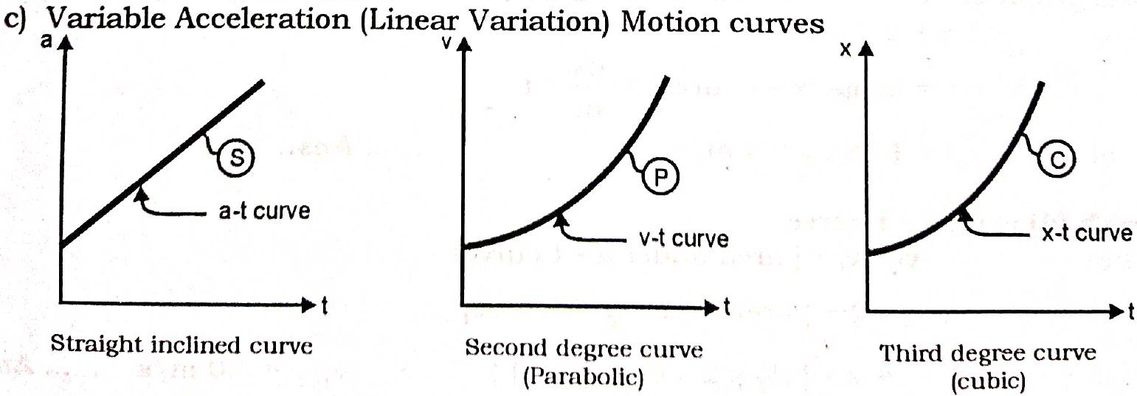
Standard Motion Curves:
It is used to identify the motion of a particle /object and find the state of its motion of uniform acceleration/ uniform velocity etc.

Slide 10
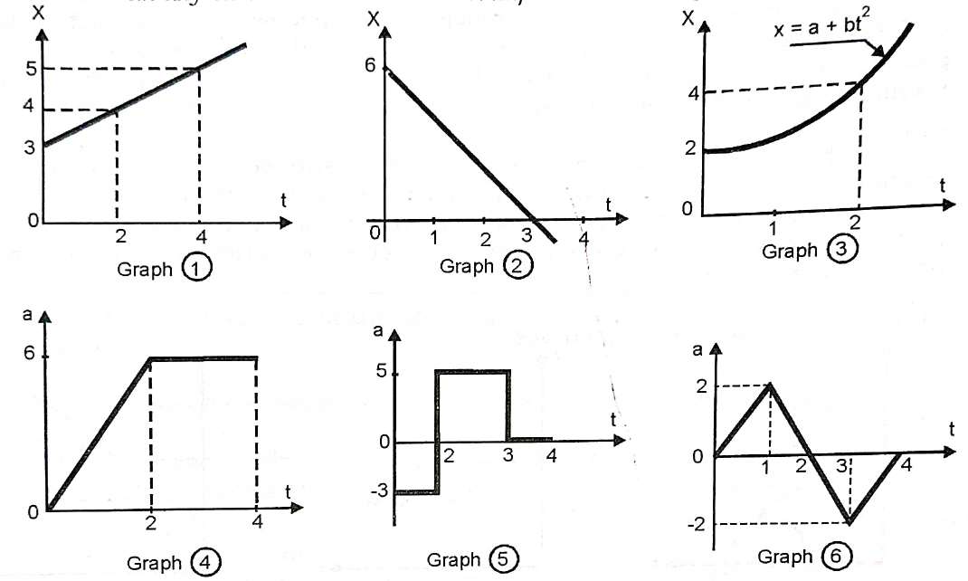

Slide 11
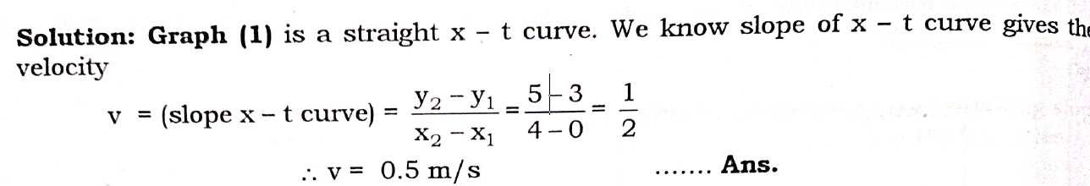
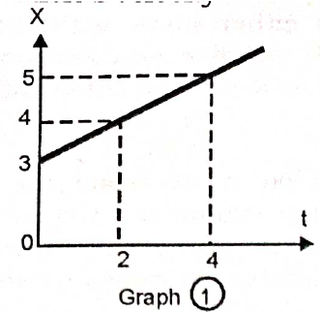
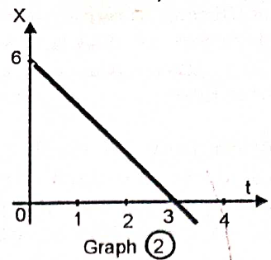
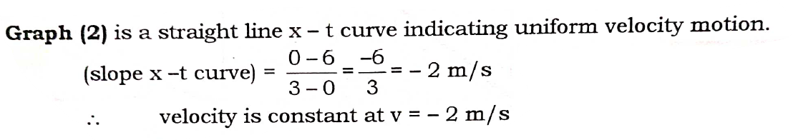

Slide 12
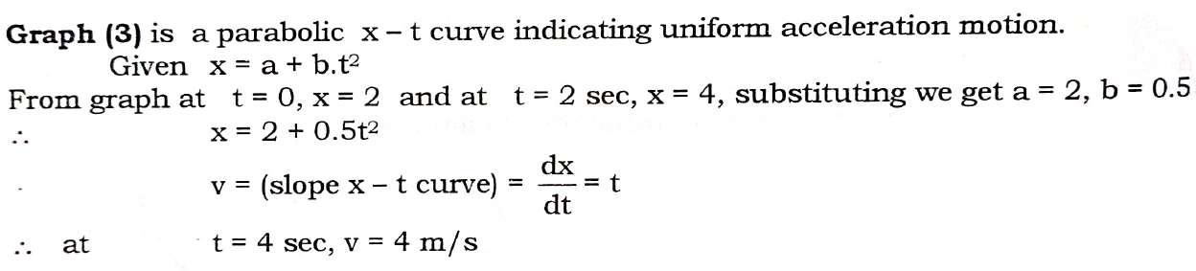
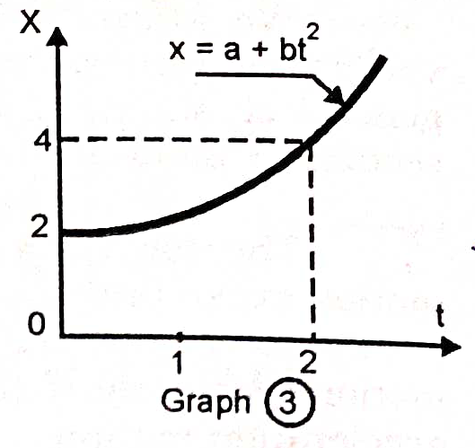
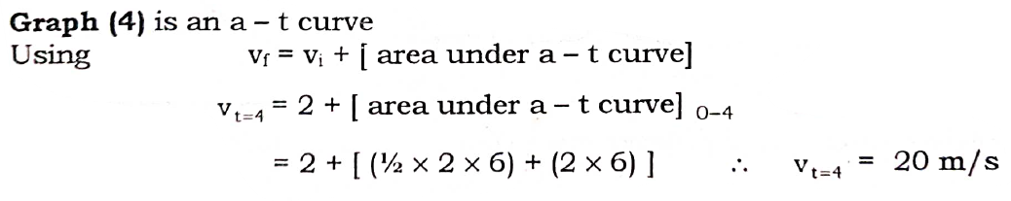
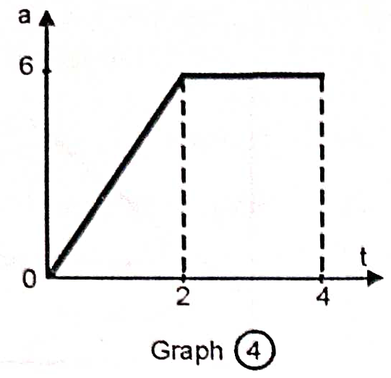

Slide 13
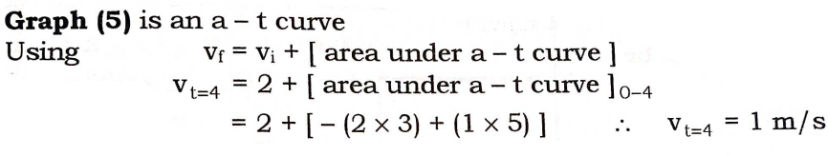
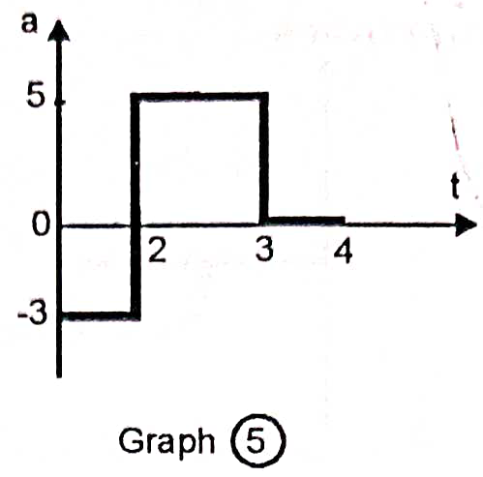
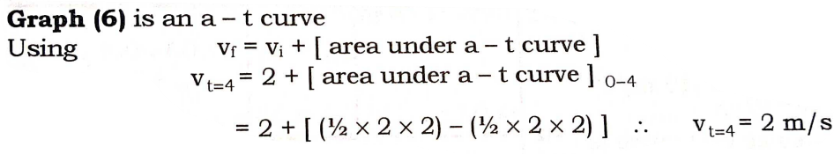
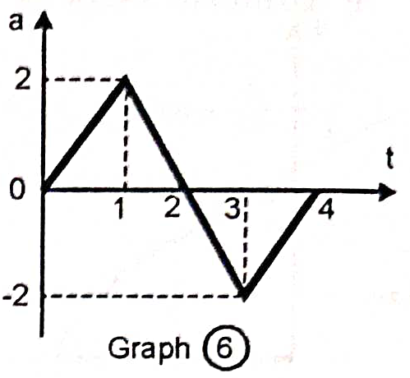

Slide 14
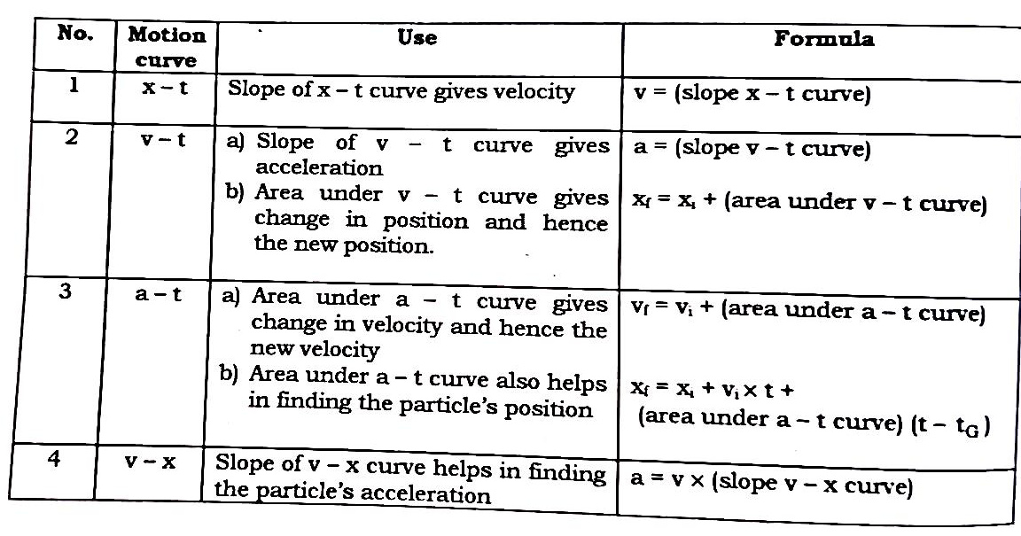

Slide 15
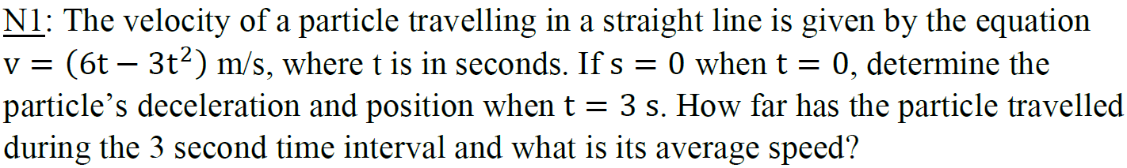
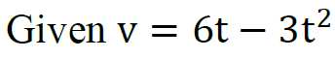
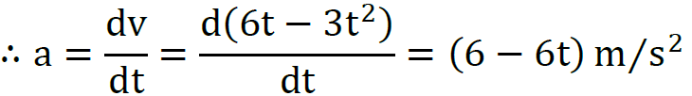
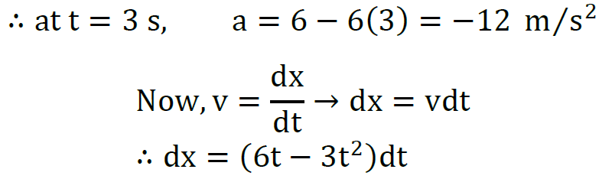
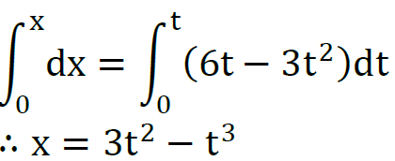
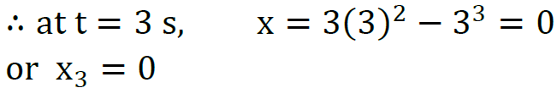
Integrating both sides going from x=0, t=0 (given) to unknown values x & t,

Slide 16
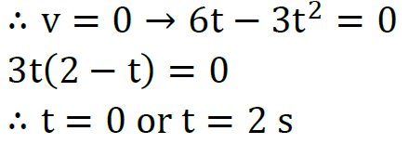
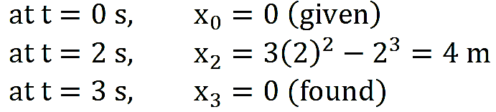
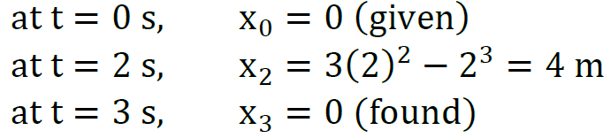
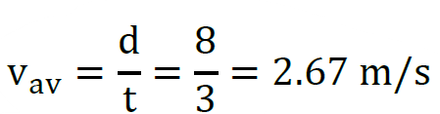
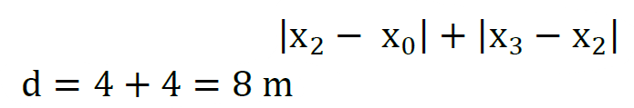
Now, to calculate distance, we must check whether the particle reverses its direction
during the time interval of 3 seconds.
For the particle to reverse, its velocity must become zero at the reversal point.
As we can see the particle must have reversed its direction. Hence, the positions at various key points is,
Hence, the total distance travelled in 3 seconds =
Hence, at t=3s, the particle’s deceleration is 12 m/s² and its position is at origin and, the particle has travelled 8 m during the 3 second time interval with an average speed of 2.67 m/s.

Slide 17
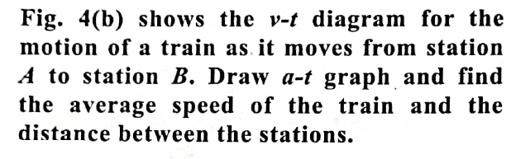
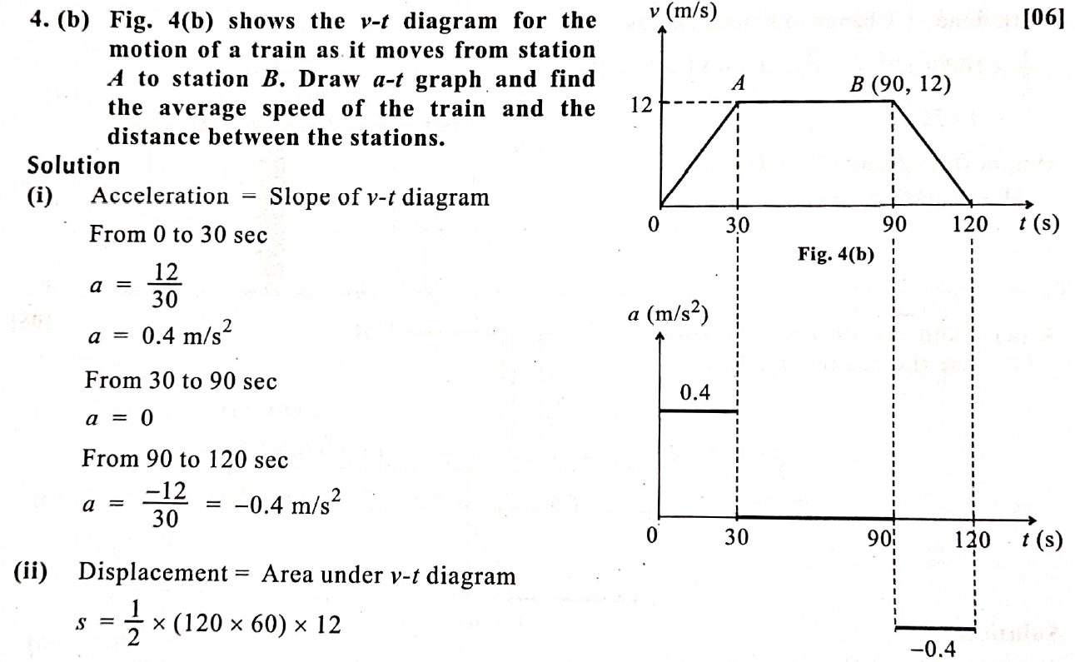
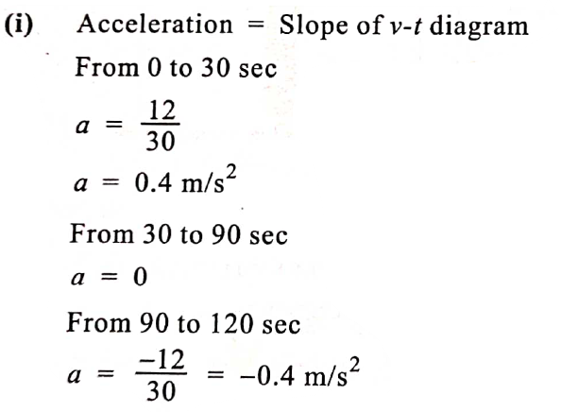

Slide 18
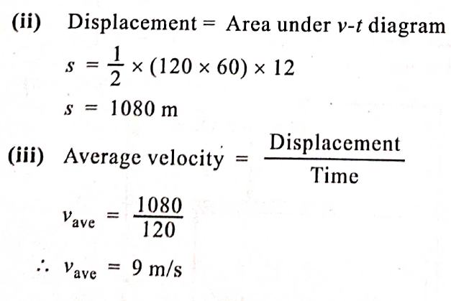

Slide 19
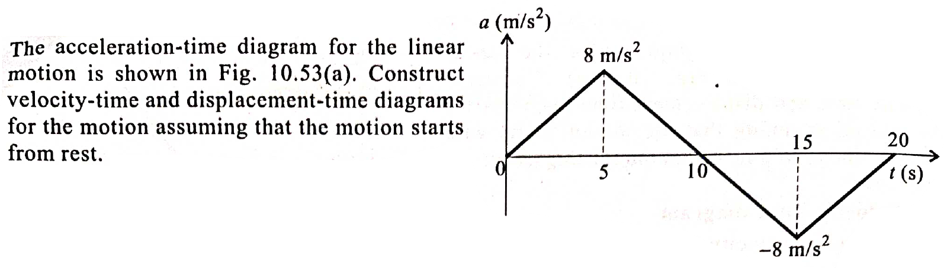
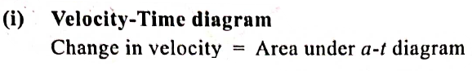
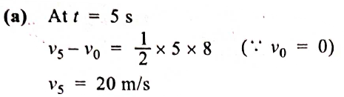
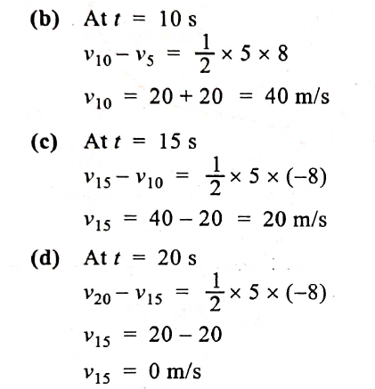
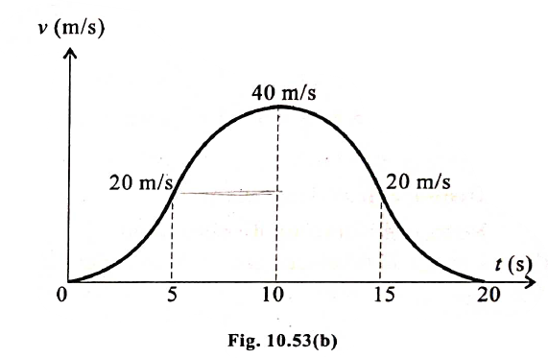

Slide 20
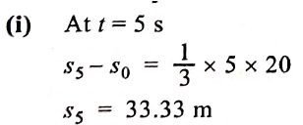
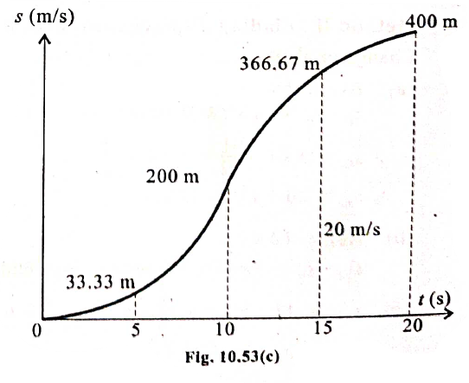


Slide 21




Slide 22





Slide 23












Slide 24









Slide 25







Slide 26




In curvilinear motion, instantaneous velocity of a particle is always tangent to the curved path at that instant.

Slide 27


Acceleration: As the direction of velocity continuously changes in a curvilinear motion, there exists acceleration at every instant of the motion.

Slide 28


Curvilinear Motion by Rectangular Component System:
Curvilinear motion can be split into motion along x, y, z directions, which can be independently considered as three rectilinear motions along those directions respectively.
For a particle in xy plane, the rectangular components will be as shown:

Slide 29


Curvilinear Motion by Tangential & Normal Component System (N-T System):
Curvilinear motion can also be studied by splitting the acceleration along the
tangent to the path and normal to the path.
The velocity vector is always directed towards the tangential direction. But the net
acceleration may be in any direction. So, it is convenient to express acceleration as
tangential acceleration ( a_{t}) and normal acceleration (a_{n} ).

Slide 30



Slide 31








Slide 32









Slide 33



Slide 34







Slide 35







Slide 36








Slide 37









